Slide 1
Applied Physics
Computer science department
Clipper Circuit
Topic :
Mahek kalani & Teesha preetmani

Slide 2
“Clipper circuit”
Also knows as Clipping circuit , limiters ,slicers e.t.c
AN application of diode
Definition:
An electronic circuit that clip off or removes a portion of an A.c signal ,without causing any distortion to the remaining part of wave form is called the clipper circuit .
OR
A clipper is a device that removes the either positive half (top) or negative half (bottom ) or some part
of positive or negative halves of A.c signal

Slide 3
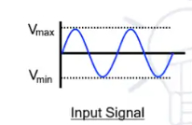
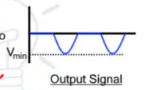
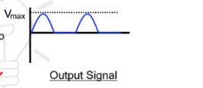
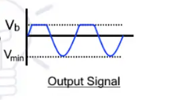
Note : A clipper does not distort the remaining part of waveform

Slide 4
Why Clipper circuit ?
Electronic device or very sensitive to voltage . If a large amplitude of voltage is applied ,it may permenantly destroy the device .so it is essential to protect the electronic circuit .
The protection of electronic device can be acheived by the using the clipper circuit (by reducing the voltage )

Slide 5
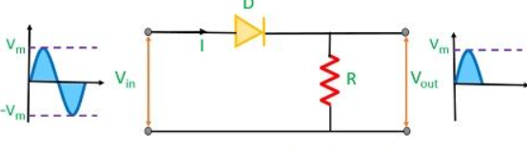
“Example of clipper circuit”
Half wave rectifier

Slide 6
Types of clipper circuit
Series diode clipper
Shunt diode clipper
Series positive clipper
Series negative clipper
Shunt positive clipper
Shunt negative clipper
Positive cycle
Negative cycle
Series positive clipper with Bias
Positive cycle
Negative cycle
Series positive clipper with Bias
Positive cycle
Negative cycle
Series positive clipper with Bias
Positive cycle
Negative cycle
Series positive clipper with Bias

Slide 7
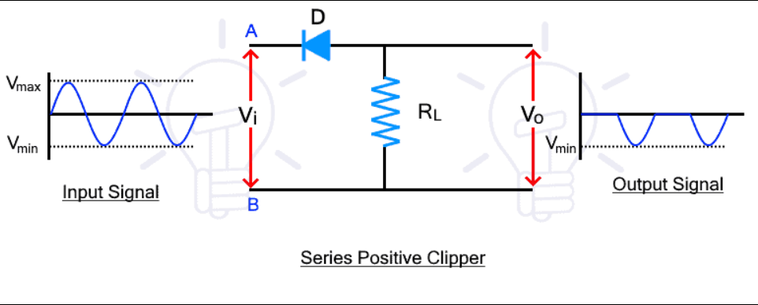
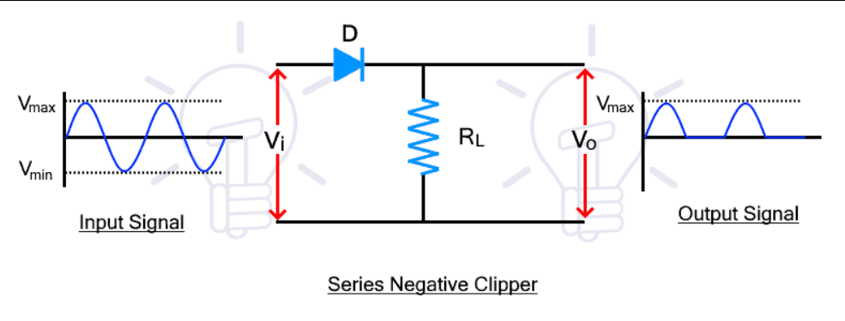
“Series diode clipper “
In series clipper circuits, the diode is connected in series with the output. In such clippers, the input signal appears at the output when the diode is forward biased and conducting.
It is divided into positive and negative clippers.
Series Positive Clippers
Series positive clippers remove or clips the positive half of the waveform. In a series positive clipper, the diode is in reverse biased and in series with the output as shown in the figure below.
Series Negative Clippers
During positive half cycle, the diode is forward biased due to the input voltage. Therefore, the input signal passes through the diode and appears at the output.

Slide 8
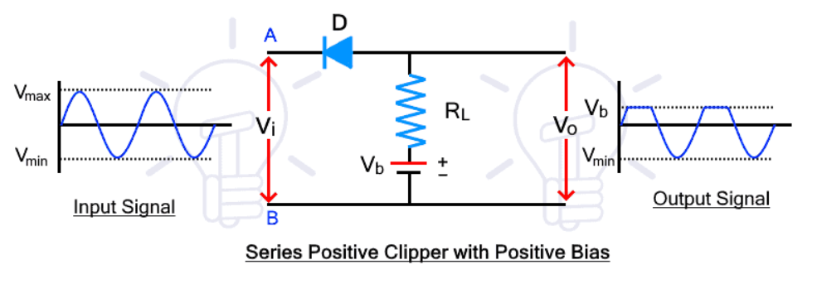
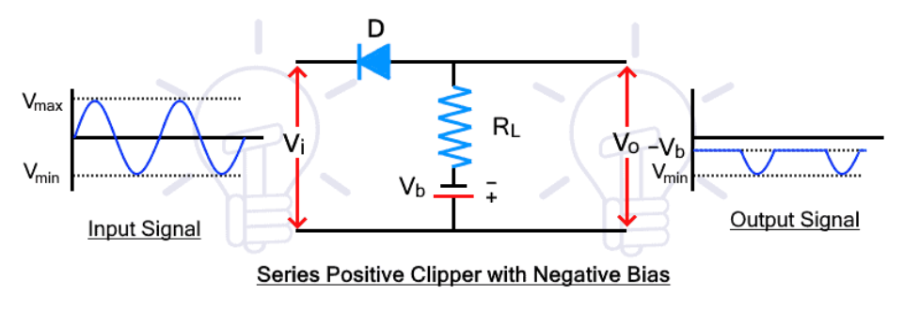
During the negative half-cycle, the voltage at point A is negative than point B. The diode becomes forward bias and the signal pass through it. The signal appears across the Rl. Therefore, the negative half cycle passes through the circuit and appears at the output.
During the negative half cycle, the diode becomes reverse-biased and it does not conduct. Therefore, there is no voltage at the output and the negative half cycle is clipped from the input waveform
Series Positive Clippers with Bias
Series Negative Clippers with bias
Positive Bias
Positive Bias
In such a positive clipper circuit, the positive of the battery is connected to the P side of the diode as shown in the figure below.
During the positive half cycle, the diode is forward biased due to input signal voltage. While it is reversed biased due to the battery voltage. the state of the diode depends on both the voltage sources. Therefore, the diode will be forward biased and conduct only if the input voltage is greater than the battery voltage.

Slide 9
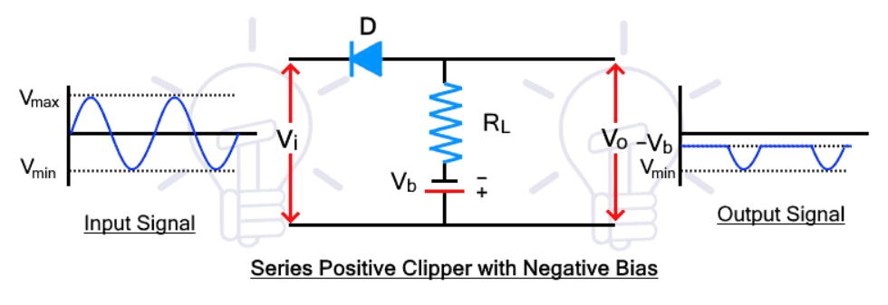
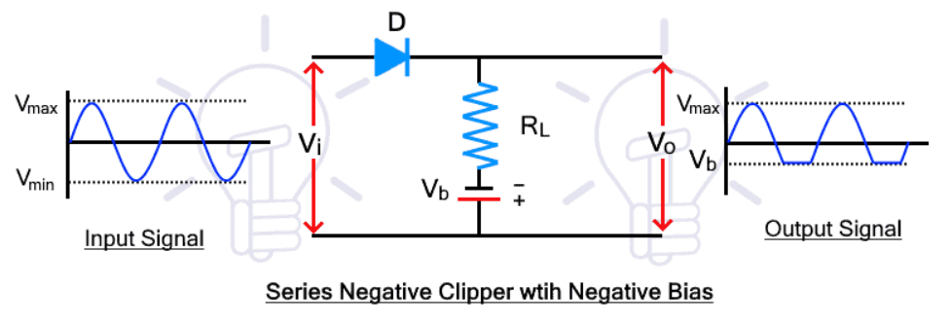
During the negative half cycle, the diode is forward biased due to the input voltage as well as the battery voltage. Therefore, the input signal passes through the diode and it appears at the output
During the negative half of the cycle, the diode is reversed biased due to both the input voltage as well as the battery voltage. therefore, only battery voltage appears at the output for the whole negative half cycle.
Negative Bias
Negative Bias
During the positive half cycle, the diode is forward biased due to both the input signal and the battery voltage. Therefore, the diode conducts the signal for the whole positive half cycle and it appears at the output as it is in the input.
During the positive half cycle, the diode is reversed biased due to the input voltage and the negative battery as well. Therefore, in the positive half cycle, the diode does not conduct and only the negative battery voltage appears at the output.

Slide 10
During the negative half-cycle, the input voltage polarity reverses and the diode becomes forward biased. However, the diode is reverse biased due to the negative battery. Therefore, the diode only becomes forward biased if the input voltage increases above the battery voltage and the input signal appear at the output. Otherwise, the negative battery voltage appears at the output.
During the negative half-cycle, the input voltage forces the diode in reverse bias but the battery voltage still forward biases the diode. During this whole cycle, the diode only conducts when the battery voltage exceeds the input voltage.
“Shunt Clippers”
In shunt clippers, the diode is connected in parallel with the output. The input signal appears the output when the diode is blocking as opposed to the series clippers.
The shunt clippers can also be divided into positive and negative clippers.
Shunt Positive Clippers
Shunt Negative Clippers

Slide 11
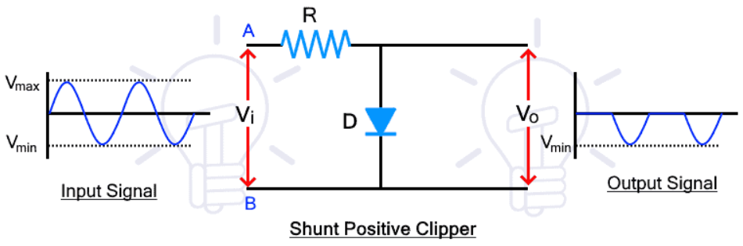
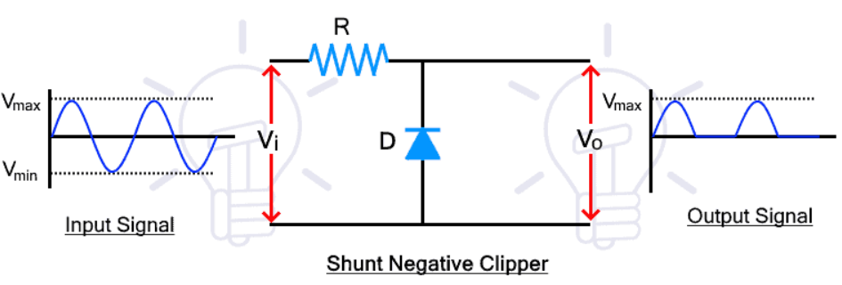
Shunt Positive Clippers
The shunt positive clipper clips the positive half cycle of the input waveform. The circuit diagram of the shunt positive clipper is given below.
Shunt Negative Clippers
The shunt negative clipper clips the negative half of the input waveform. The circuit diagram is given below
During the positive half cycle, the diode is forward biased as the voltage at point A is greater than point B. so the diode conducts the input signal and there is no voltage difference at the output.
During the positive half cycle, the diode is reversed biased, thus it blocks the signal that appears across it. therefore, the positive half also appears at the output.

Slide 12
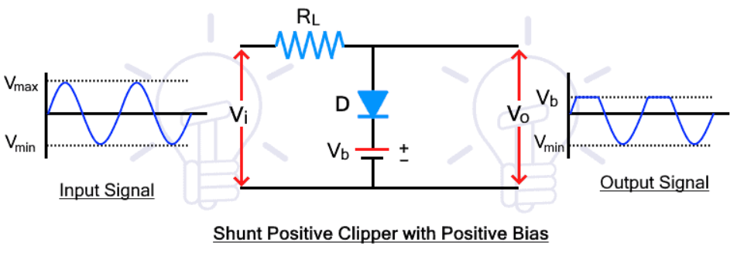
During the negative half-cycle, the voltage polarity of the input signal at points A and B reverses and the diode becomes reverse biased. Therefore, the diode blocks the input signal and the signal voltage appears across the diode that is taken as the output of the clipper.
During the negative half cycle, the diode is forward biased and it conducts the signal. Therefore, there is no voltage at the output for the negative half cycle. Thus the shunt negative clipper clips or removes the negative half of the input waveform.
Shunt Positive Clippers with Bias
Positive Bias
During the positive half cycle, the diode is forward biased due to the input voltage. but it is reversed biased due to the battery voltage. The sum of both voltages will decide the state of the diode. If the input voltage is greater than the battery voltage, the diode will be forward biased otherwise it will remain in reverse bias.

Slide 13
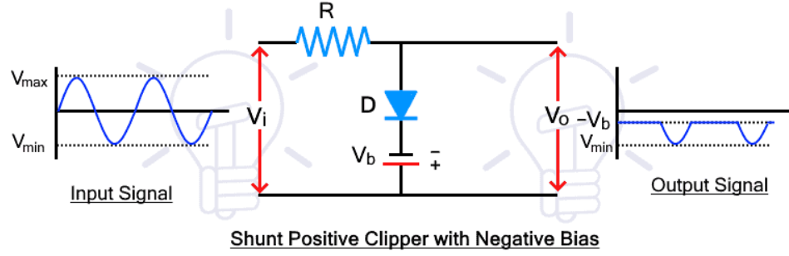
During the negative half cycle, the diode is reversed biased due to both input voltage as well as battery voltage. Therefore, the input signal appears for the whole negative half-cycle at the output
Negative Bias
During the positive half cycle, the diode is forward biased for both input signal and battery voltage. Therefore, the diode conducts for the whole cycle and only the battery voltage appears at the output.

Slide 14
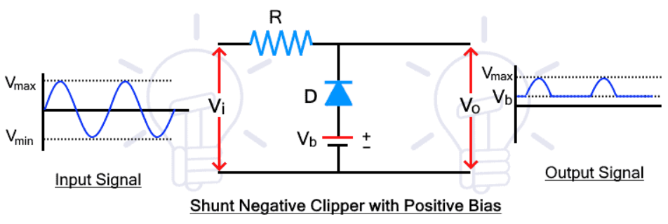
During the negative half cycle, the diode is reversed biased for input signal and forward biased for battery voltage. The combined effect of both voltage sources decides the state of the diode. The diode is forward biased when the input voltage is less than the battery voltage
Shunt Negative Clippers with Bias
Positive Bias
During the positive half cycle, the diode is reversed biased for input voltage but forward biased for battery voltage. So, the diode will be reversed biased only when the input voltage exceeds the battery voltage and then the input signal will appear at the output

Slide 15
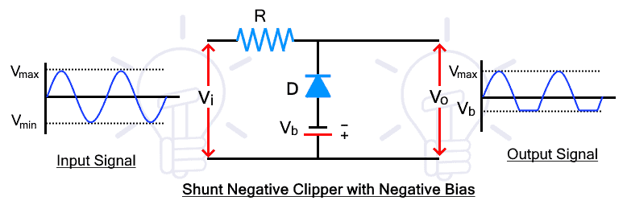
During the negative half cycle, the diode is forward biased for both input signal and battery voltage. Therefore, the diode conducts and only the battery voltage appears at the output for the whole negative cycle.
Negative Bias
During the positive half cycle, the diode is reversed biased for both input and battery voltage. thus, the diode blocks the voltage and the signal appears at the output for the whole positive half cycle.

Slide 16
During the negative half cycle, the diode conducts when the input voltage exceeds the battery voltage. Therefore, when the voltage is less than the battery voltage, the diode blocks and the signal appears at the output. When the input voltage exceeds, the diode starts conduction and only the battery voltage appears at the output.
“Applications of Clipper”
The main purpose of the clipper circuit is to modify the waveform of the signal which can be used in several applications such as in protection against overvoltage, noise removal, transmission, etc.
The clipper circuit offer overvoltage protection therefore, it is used in power supplies for limiting the voltage.
They are used for filtering noise in transmitters.
They are used in transmitters and receivers of television.
They are used for modifying or generating new waveforms such as square, triangular, etc.

Slide 17
THANKYOU

